Slide 1
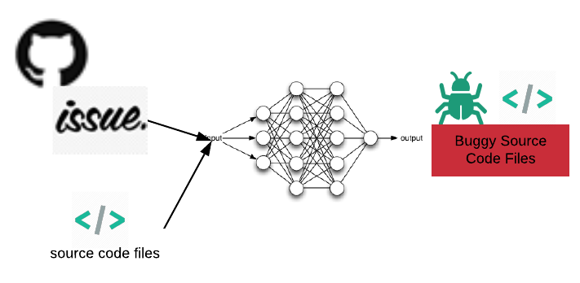
Leveraging traceability Information between Issue Report and source code through
deep neural networks
Thazin AUNG
Work in progress..

Slide 2
Outlines
Background
Problem
Related Works
Our Approach
Motivation

Slide 3
Background
Bug/Issue Report Sample
Bug Resolution Life Cycle
Recap my previous idea

Slide 4
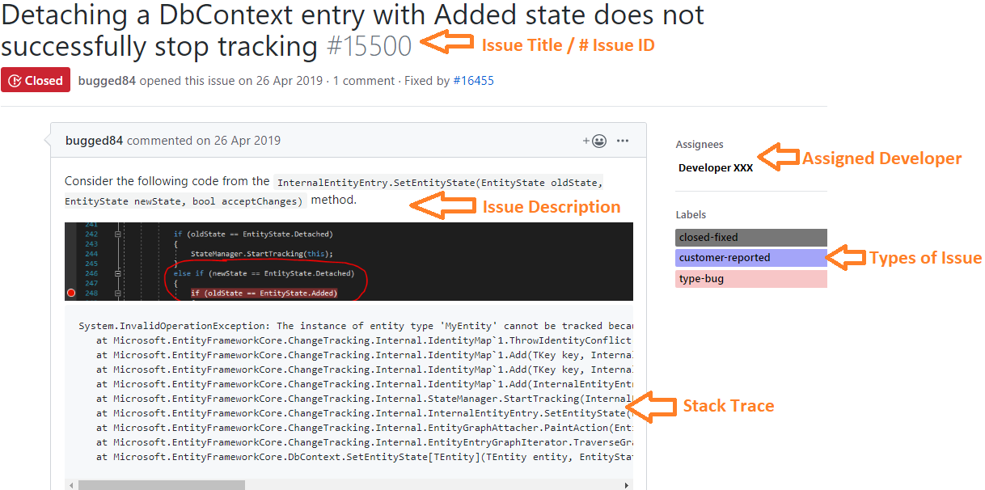
Background (Part 1/3)
Issue Report : also known as a bug report, includes description of the errors, stack traces, code snippets, and screenshots .
Fig. Issue Reports from GitHub Roslyn Projects

Slide 5
Background (Part 2/3)
Opened
New
Assigned
Resolved
FIXED
INVALID
WONTFIX
DUPLICATE
WORKSFORME
Reopened
Verified
Bug Resolution Life Cycle
Open - New Bug
New – Is it a new bug or feature request. Allocating the appropriate label.
Assigned – assign the bug to a qualified developer
Resolved – an assigned developer locate the buggy source code files and fixed the errors
Verified - Verify Is the bug is fixed?
Reopened
Closed – Close the bug report
Closed
Fig 1. Bugzilla’s Bug resolution life cycle (Shihab et al., 2012)

Slide 6
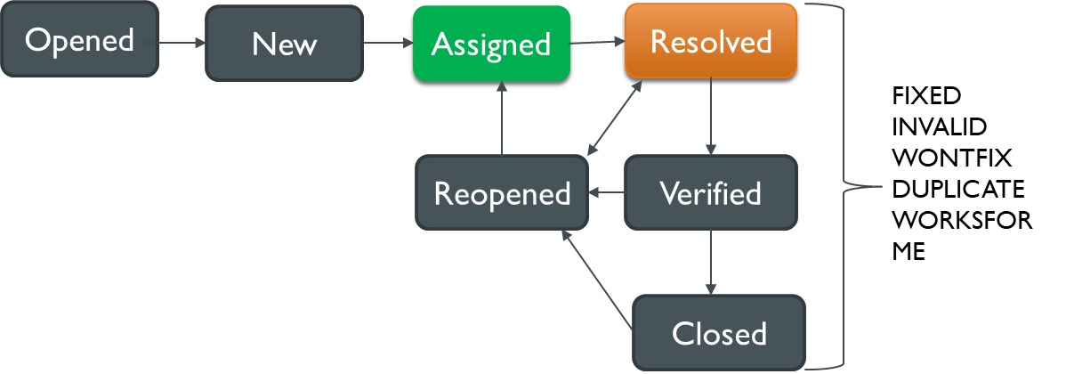
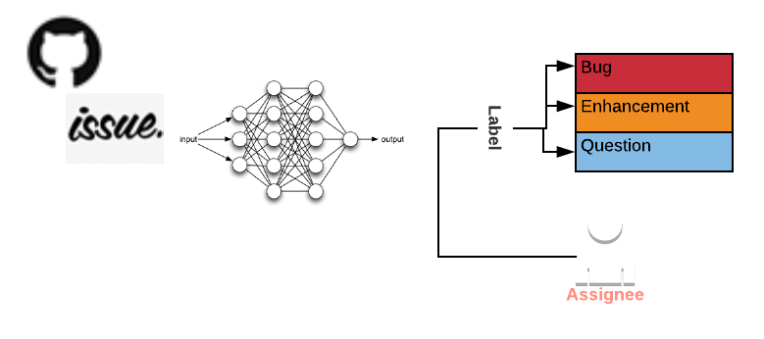
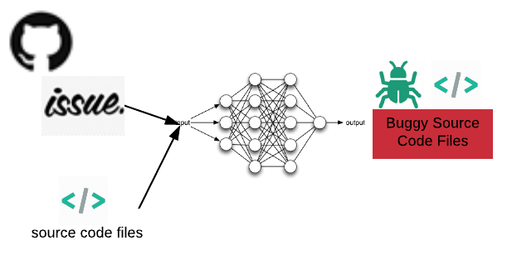
Background (Part 3/3) - Recap
Assigned
My previous approach focused on recommending Developer and Label using exiting issue reports. I applied Sentence Embedding, Feed Forward Neural Networks, and Text Classification approach.
Resolved
In this approach, we are focused on recommending related Source Code files using issue reports (new + existing issue reports). I applied Sentence Embedding, Text Clustering, Wiki-based spelling checking approach and Code2Seq.
Notes:
Word Vectors are designed to capture meaning of the words

Slide 7
Statement of problem
In open source software development environment
Managing a growing number of issues reports efficiently become a challenging task, especially the project is maintained by the multiple developers
An assigned developer need to have a good knowledge of the current state of the system to locate the buggy source code files
Usually, a developer needs to manually reproduce the abnormal behaviour as it is times Time-consuming and Error-prone.
Due to GitHub annual statistics report, there is a total of 20 Millions issues reported in GitHub issue tracking system.

Slide 8
Related Works
Related Works
Explain One Recent Paper
Limitations

Slide 9
Related Works
Previous works can be broadly categorized into two categories
Information Retrieval Based Approach (Traditional Approach)
Machine Learning Based Approach (Recent Approach)

Slide 10


Related Works
Information Retrieval Based Approach
IR Based Approach it extracted the contents of the issue reports and features of source code class files
(i.e., file names, classes, comments, methods, identifiers), and measured the similarity using texts.
1.Extract
Issue Reports
(Title, Description)
Source Code
(file names, classes, comments, methods, identifiers)
Vector Space Model,
Latent Semantic Indexing,
Latent Dirichlet Allocation
+ Cosine Similarity
2.Compute Similarity
3. Rank the list of Source code files based on similarity score

Slide 11
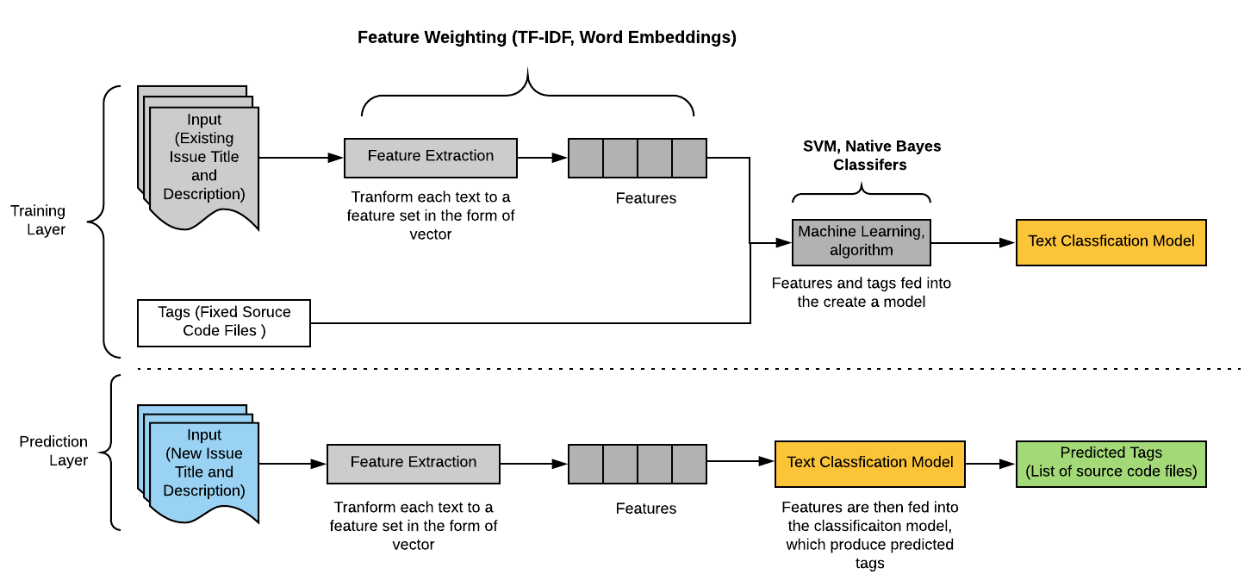
Related Works
Machine Learning Based Approach
It used content of previous fixed issue report, and its corresponding fixed source code files as labels to train machine learning classifiers. Multiclass text classification – automated sorting of texts into categories according to its content.

Slide 12
One Recent Paper
Purpose
Architecture

Slide 13
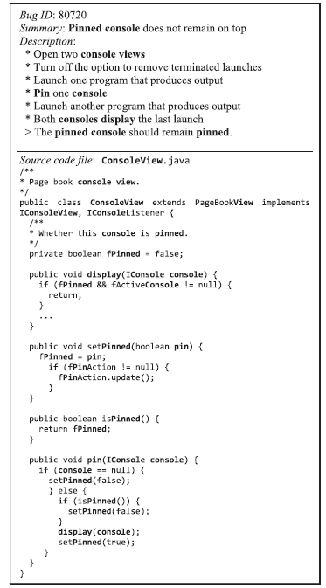

Leveraging textual properties of bug reports to localize relevant source files
Purpose
The authors presents a multi-component bug/change localization approach to automatically identify the faulty source code files based on the relations between bug reports and source code files. The approach combined revised Vector Space Model (rVSM), word embedding and machine learning techniques to find all the relevant faulty source code files.
(Gharibi, Rasekh, Sadreddini, & Fakhrahmad, 2018)

Slide 14

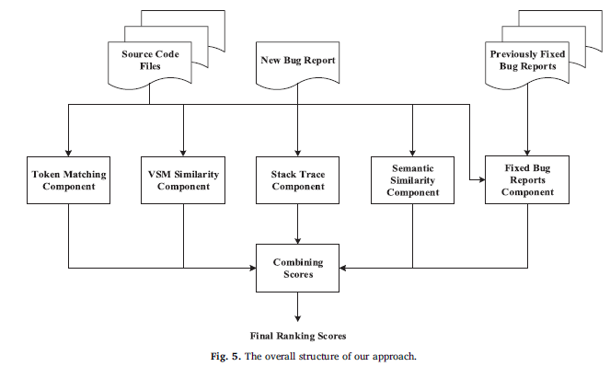

Leveraging textual properties of bug reports to localize relevant source files
Architecture
1
2
3
4
5
6
6

Slide 15
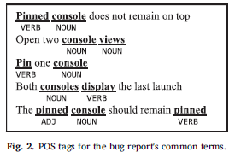


Architecture
1
Token matching component
No | Equation | Used Features | Description
1 | count (matched tokens) | Bug report’s POS tagged summary and description Source code file name, class names, method name | Count how many bug reports terms match with source code file terms
2 | count (matched tokens) − count (comments tokens) | Bug report’s POS tagged summary and description Source code file comments | Count how many bug reports terms match with source code comments terms Subtraction part adjusts the significance of the second step’s score compared the first step score
3 | count (matched tokens) − count (attribute tokens) | Bug report’s POS tagged summary and description Source code file attribute names | Count how many bug reports terms match with source code attribute name
Final |  |  | For each bug report, the scores of source code files are normalized using a min-max normalizer to scale from 0 to 1/.
Notes:
The approach aggregates the below three matching scores to compute “token matching components scores ”

Slide 16





Architecture
2
rVSM Similarity Score
No | Equation | Used Features | Description
1 |  | Bug report’s POS tagged summary and description Source code file name, class names, method names, attribute names, POS tagged token in comments | Calculate the tf-idf vectors for each bug report and source code file
2 |  | bug report and source code vectors | normalized TF-IDF vectors output from step 1 using the Euclidean norm
3 |  | Normalized bug report and source code vectors | Calculate the cosine similarity between bug report vector and source code vector
4 |  | The terms used in this function are the same ones used for building the source files’ vectors (i.e., the tokens from file name, class names, method names, attribute names, and POS tagged tokens in comments) | Used Source code file length score because different forms of length functions produce better overall precision and recall result
5 |  | cosine similarity scores and source code file length scores from step 3 and 4 | Combine cosine similarity scores and source code file length source to produce final results
Notes:
In Eq. 1 tfi,d denotes the term frequency which is the number of occurrences of the term i in document d, #src_files is the total
number of source files in the collection and dfi refers to the document frequency of the term i which is the number of documents that
term appears in. the resulting tf–idf vectors are then normalized by the Euclidean norm:
In Eq 3, where →Vb and →Vs are the vector of term weights for bug report b and source file s and the numerator is the dot product of these two
vectors. →Vb and →Vs indicate the length of the vectors and is computed as follows for a vector of document d:

Slide 17

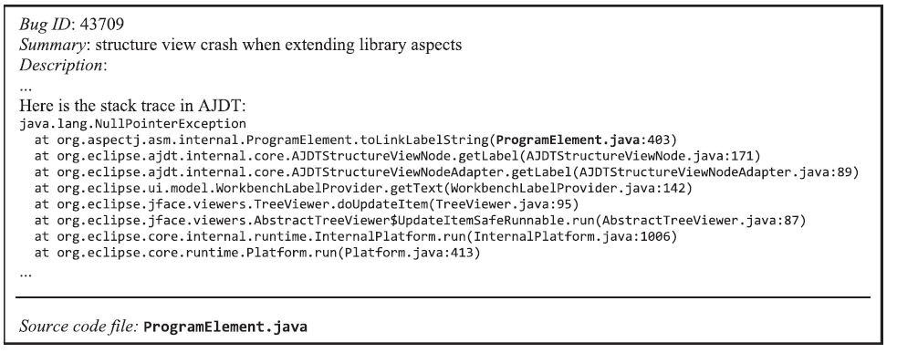

Architecture
3
Stack Trace component
Extract the source code file name from stack trace components and calculate the ranking score for faulty source files. The approach rank score source files based on the rank of each file in the stack trace as:

Slide 18

Architecture
4
Semantic similarity component
No | Equation | Used Features | Description
1 |  | Un stemmed or full-term tokens of bug reports and source file | Calculate GloVe word vector for each bug report and source code file. GloVe is also an unsupervised algorithm for constructing word vector It uses word occurrences in a corpus as its source of information and builds a word-word co-occurrence matrix and then employs matrix factorization to build word vectors. Similar to Skip-gram and CBOW model, but it used the words from the whole corpus to calculate the co-occurrence matrix rather than based on fixed window
2 |  | Normalized bug report and source code vectors | Calculate the cosine similarity between bug report vector and source code vector
https://www.youtube.com/watch?v=ASn7ExxLZws

Slide 19
Architecture
5
Fixed bug reports component
Use the Native Bayes Machine learning classifier with existing bug reports and labels with source code file names.
Existing Bug Reports
Predict Source Code file Name (Label)
Corresponding Source Code file Name (Label)
ML Native Nayes Classifier
https://github.com/h4iku/bug-localization/blob/master/
Notes:
The distribution is parameterized by vectors θy = (θy1,⋯,θyn) for each label y, where n is the number of features and θyi
is the probability P(xi | y) of feature i appearing in a sample belonging to label y. The parameters θy are estimated by a smoothed
version of maximum likelihood:

Slide 20
Architecture
6
https://github.com/h4iku/bug-localization/blob/master/buglocalizer/token_matching.py
Notes:
The distribution is parameterized by vectors θy = (θy1,⋯,θyn) for each label y, where n is the number of features and θyi
is the probability P(xi | y) of feature i appearing in a sample belonging to label y. The parameters θy are estimated by a smoothed
version of maximum likelihood:

Slide 21
Limitation
Information Retrieval Based Approach
It is based on (TF-IDF) features extraction technique. It creates issue report terms and source code files matrix and counts each issue report term occurrence in source code files. It did not capture any meaning and relations between words. Semantic similarity problem exists in this approach.
Machine Learning Approach
Multiclass text classification approach cannot suggest source code files if there is no existing fixed issue report
Word embedding model learns a representation of issue reports by embeddings each word into vectors. Therefore it lost the context and incentive to words order in the sentence
Lost of context
Sensitive to misspelling or technical terms
E.g., “avoid crash on concat on structs with to string member (concat == concatenation)
Insensitive of words order in the sentence
In both approach, extract certain features for source code (e.g., class name , method name, identify names) as lexical gap problem still exists
E.g., Issue Report are written in Natural Language and Source code is written in Programming Language
Notes:
E.g. “I arrived at the bank after crossing the road.”
“I arrived at the bank after crossing the river.”
E.g., Don’t remove the number from the cell, I want it in here
-VS-
I don’t want the number in the cell, remove it from here

Slide 22

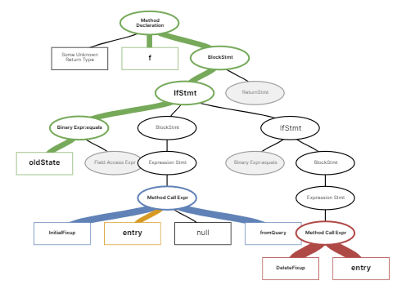

Motivation
Motivation Example
1
Issue ID : 15500
Open On: | 26 Apr 2019 | Closed On: | 6 Jul 2019
Title: | Detaching a DbContext entry with Added state does not successfully stop tracking
Description: Consider the following code from the InternalEntityEntry. SetEntityState(EntityState oldState, EntityState newState, bool acceptChanges) method. System.InvalidOperationException: The instance of entity type 'My Entity' cannot be tracked because another instance with the key value '{Id: 8962cb17-bef4-4ae9-a247-494129381fe2}' is already being tracked. When attaching existing entities, ensure that only one entity instance with a given key value is attached. at Microsoft.EntityFrameworkCore.ChangeTracking.Internal.IdentityMap`1. ThrowIdentityConflict (InternalEntityEntry entry) at Microsoft.EntityFrameworkCore.ChangeTracking.Internal.IdentityMap`1.Add(Key key, InternalEntityEntry entry, Boolean updateDuplicate) at Microsoft.EntityFrameworkCore.ChangeTracking.Internal.IdentityMap`1.Add(Key key, InternalEntityEntry entry) at Microsoft.EntityFrameworkCore.ChangeTracking.Internal.IdentityMap`1.Add (InternalEntityEntry entry) at Microsoft.EntityFrameworkCore.ChangeTracking.Internal.StateManager. StartTracking (InternalEntityEntry entry) at Microsoft.EntityFrameworkCore.ChangeTracking.Internal.InternalEntity Entry.SetEntityState (EntityState oldState, EntityState newState, Boolean acceptChanges) at Microsoft.EntityFrameworkCore.ChangeTracking.Internal.EntityGraphAttacher. PaintAction (EntityEntryGraphNode node, Boolean force) at Microsoft.EntityFrameworkCore.ChangeTracking.Internal. EntityEntryGraphIterator. TraverseGraph[TState] (EntityEntryGraphNode node, TState state, Func`3 handleNode) at Microsoft.EntityFrameworkCore.DbContext.SetEntityState[TEntity](TEntity entity, EntityState entityState)
Source code file : NavigationFixer.cs
namespace Microsoft.EntityFrameworkCore.ChangeTracking.Internal { public class NavigationFixer: INavigationFixer { public virtual void StateChanged(InternalEntityEntry entry, EntityState oldState,bool fromQuery) { if(oldState == EntityState.Detached) { InitialFixup(entry , null, fromQuery:false); } else if(entry . EntityState == EntityState.Detached) { DeleteFixup(entry); } } } }
1
2
3
2
Issue ID : 15645
Open On: | 7 May 2019 | Closed On: | 6 Jul 2019
Title: | Refreshing Db Context single entity with ReloadAsync after using raw SQL to delete data results with strange behaviour
Description: I'm facing a strange behavior when I try to refresh single entity form Db Context using .ReloadAsync for tracked entity.Simply after deleting the single entity using raw SQL and forcing EF to reload changes form DB is not enough to delete the entity from the cache.
3
Issue ID : 13110
Open On: | 24 Aug 2018 | Closed On: | 6 Jul 2019
Title: | Entity doesn't get removed from collection when setting reference to null if parent is deleted
Description: If a Blog entity is in the state Deleted, and I change a Post's navigation property to no longer point at the Blog, then the Post doesn't get removed from the collection.It works fine if the parent's state is not Deleted, and adding also works, just removing doesn't. The relationship is optional/ null able and all property setters raise PropertyChanging/Property Changed. I'm using ChangeTrackingStrategy.ChangingAndChangedNotificationsWithOriginalValues.
Fig. Issue Reports from GitHub Roslyn Projects

Slide 23
Our Approach
Enhancement
Sentence Embedding Based Issue Reports Vectors
Clustering
Wiki-Based Spelling Correction
CodetoSeq
Process Workflow (Draft..)

Slide 24
Enhancement
 | Limitation of Previous Approach | Solution
1 | Lost of context, Insensitive of words order | Create Issue Reports Vector in Sentence Embedding Approach
2 | Do not have history of fixed issue reports | Group the new similar issue reports together using Clustering technique
3 | misspelling or technical terms | Wiki-based spelling checking approach
4 | lexical gap problem | Code to natural language Sequence vector (Code2Seq) model to predict overall objective of the function/method
Notes:
Lost of Context – word embedding model cannot train to interpret the meaning of words according to the context.
ML Classification Model – relies the previous issue report to suggest the potential source code file to fixed
Normal Spelling Checker – cannot able to recognize technical short terms from issue reports

Slide 25
Clustering (Part 1/3)
Objectives
Clustering – is the technique that find groups of similar objects. Objects that are more related to each other than to objects in other groups.
In our case, it is grouping of similar bug reports together.
K-mean – is the unsupervised learning algorithm to discover underlying pattern of dataset.
In our case, the objective of K-means is to find similar groups of bug report to enrich the context of bug report information to recovery traceability links bug reports and source code files more precisely.

Slide 26
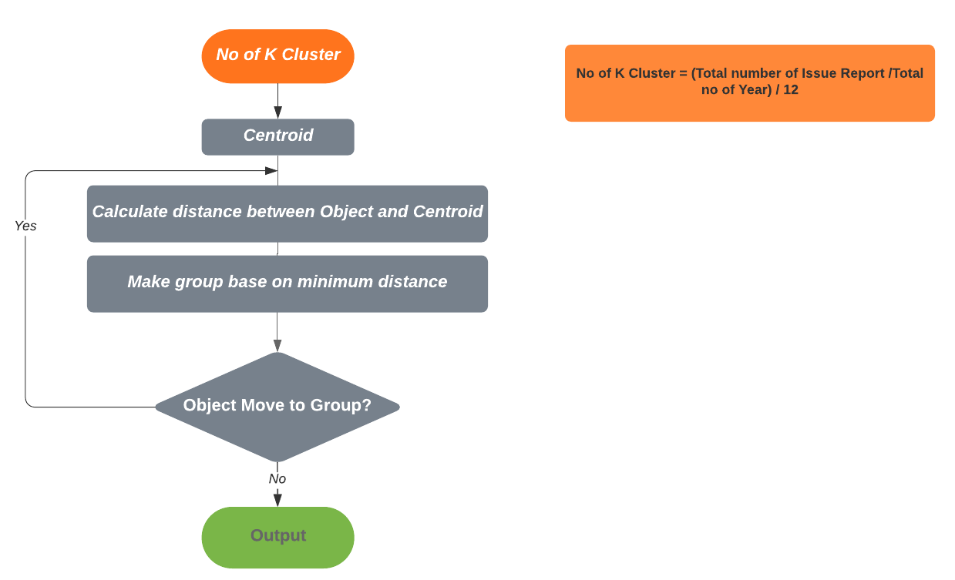
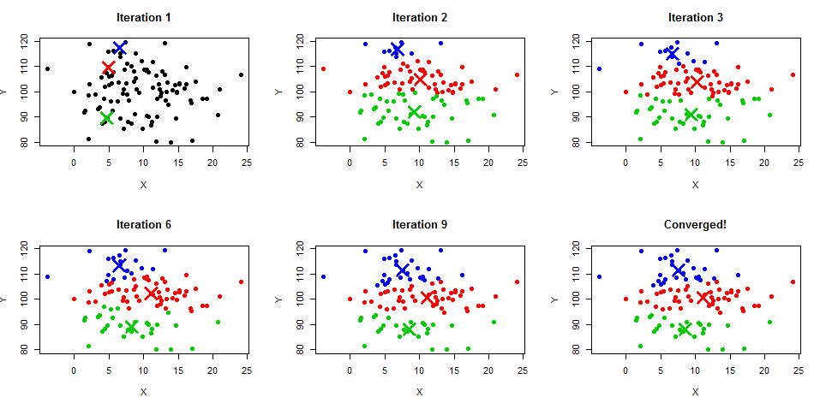
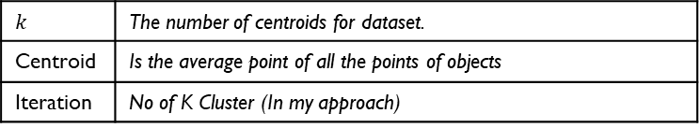
Clustering (Part 2/3)
K-Mean Flow Chart
$$k$$ | The number of centroids for dataset.
Centroid | Is the average point of all the points of objects
Iteration | No of K Cluster (In my approach)
Notes:
-

Slide 27




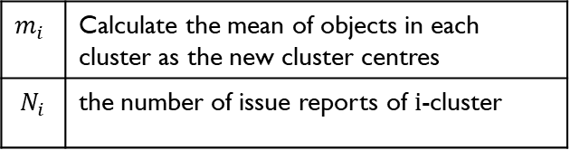

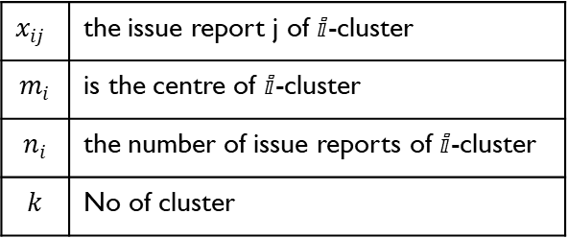

Clustering (Part 3/3)
K-mean standard algorithm
Square Error Criteria Clustering
Calculate Centre of $ⅈ$-cluster
Calculate Distance (Issue Reports, Cluster)
$$x_{ij}$$ | the issue report j of $ⅈ$-cluster
$$m_{i}$$ | is the centre of $ⅈ$-cluster
$$n_{i}$$ | the number of issue reports of $ⅈ$-cluster
$$k$$ | No of cluster
$$m_{i}$$ | Calculate the mean of objects in each cluster as the new cluster centres
$$N_{i}$$ | the number of issue reports of $ⅈ$-cluster
$d(x_{i}m_{i}$) | Distance between issue report $ⅈ$ and cluster $j$
Notes:
The objective of this function is to find the optimal cluster group for the given issue reports collection

Slide 28

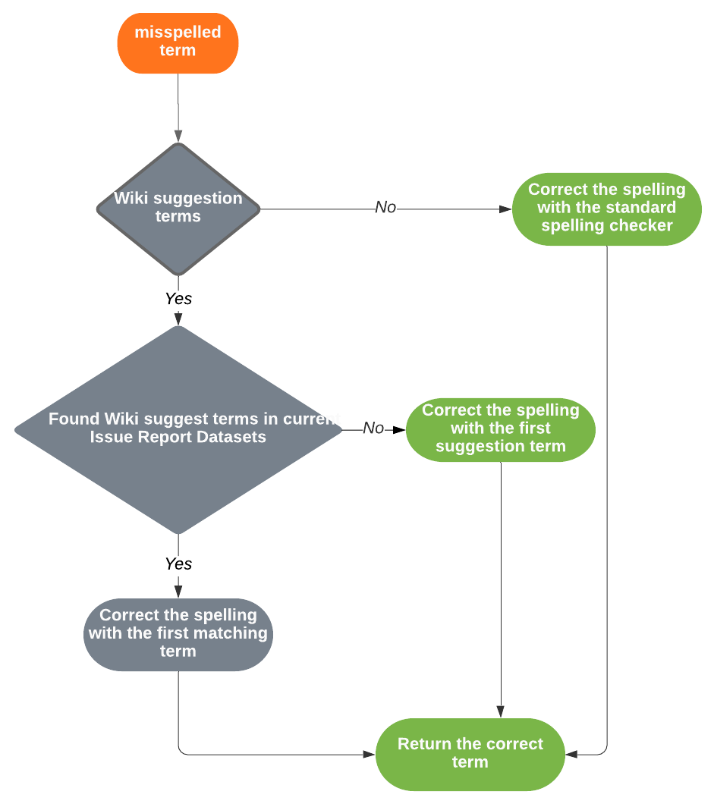
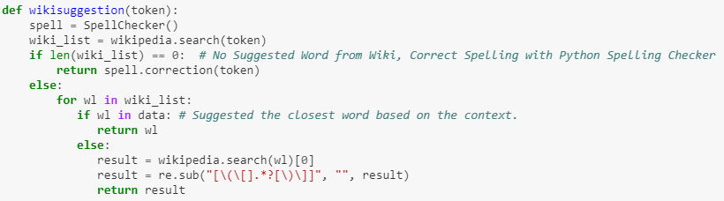
Wiki-based Spelling checking
E.g., “avoid crash on concat on structs with to string member (concat == concatenation)

Slide 29
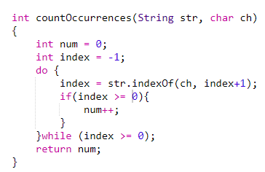
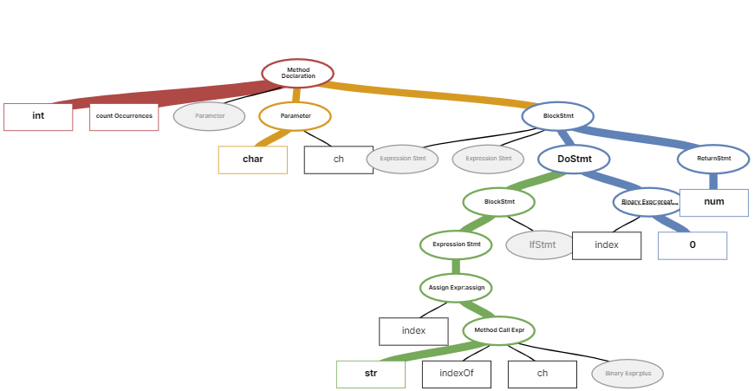

Code to natural language Sequence vector (Code2Seq) (1/3)
Objectives
Code2Seq - is a neural network model which can generalize and predict the likely property of source code snippets. The model uses abstract syntax tree (AST) structure of the program as encoding vectors and applied attention mechanism based neural network model to decode the natural language sequence.
AST - abstract syntax tree or just syntax tree is a tree representation of the abstract syntactic structure of the source code written in programming language.
Terminals – The leaves of the tree are called terminals (e.g., name such as num, int, str )
Non-Terminals – The none-leaf nodes called non-terminals (e.g., loops, expression, and variable declaration)
(Alon, Brody, Levy, & Yahav, 2018)
Notes:
Predict the overall objective of the function.

Slide 30
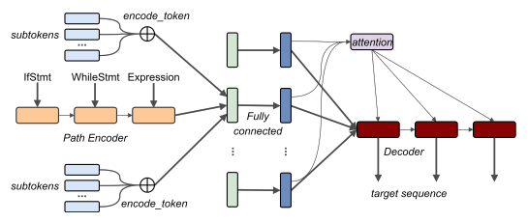


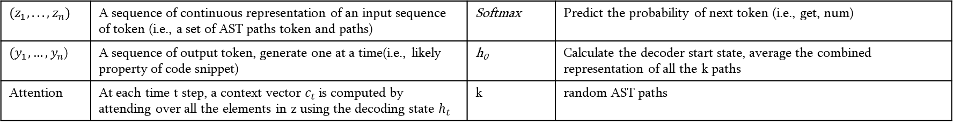
Code to natural language Sequence vector (Code2Seq) (2/3)
High Level Architecture
LSTM
$${(z}_{1},...,z_{n})$$ | A sequence of continuous representation of an input sequence of token (i.e., a set of AST paths token and paths) | Softmax | Predict the probability of next token (i.e., get, num)
${(y}_{1}{,…,y}_{n}$) | A sequence of output token, generate one at a time(i.e., likely property of code snippet) | h₀ | Calculate the decoder start state, average the combined representation of all the k paths
Attention | At each time t step, a context vector $c_{t}$ is computed by attending over all the elements in z using the decoding state $h_{t}$ | k | random AST paths
(Alon, Brody, Levy, & Yahav, 2018)

Slide 31
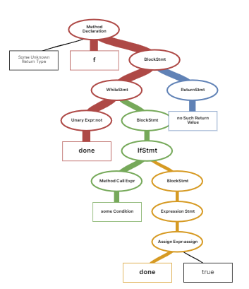
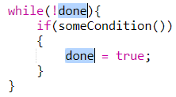
Code to natural language Sequence vector (Code2Seq) (3/3)
AST Encoder
Representing AST-Paths as two set of Vectors
Token vectors
Path vectors
Lookup (token vectors)
Lookup (path vectors)
Lookup (token vectors)
(done, SynbolRef|UnaryPrefix|While|If|Assign=| SynbolRef, done)
(Alon, Brody, Levy, & Yahav, 2018)

Slide 32
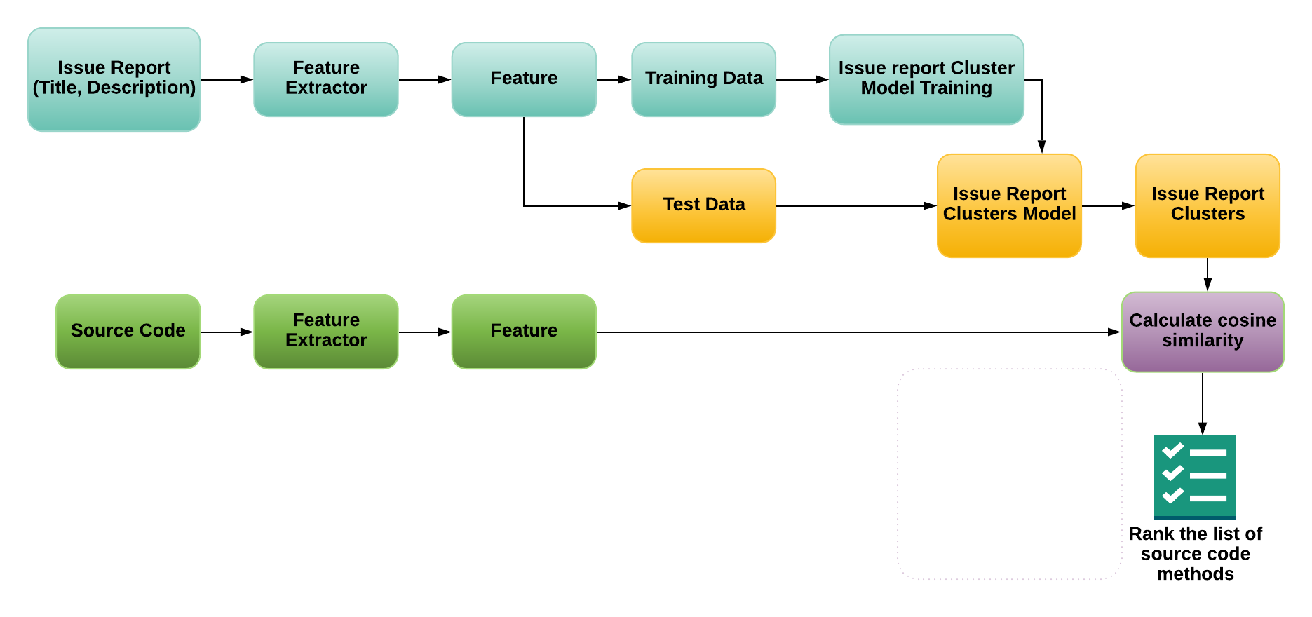
Process Workflow (Draft)
Issue Reports Sentence embedding
Map (Issue Report Clusters, groups of issue reports sentence embedding vectors)
Stop word removal
Wiki-based spelling checking
Embed Code2Seq Prediction List and AST for each method
Extract all methods
Create AST for each method
Get Code2Seq Predictions list of each method

Slide 33
References
Gharibi, R., Rasekh, A. H., Sadreddini, M. H., & Fakhrahmad, S. M. (2018). Leveraging textual properties of bug reports to localize relevant source files. Information Processing & Management, 54(6), 1058-1076. doi:https://doi.org/10.1016/j.ipm.2018.07.004
Shihab, E., Ihara, A., Kamei, Y., Ibrahim, W., Ohira, M., Adams, B., . . . Matsumoto, K.-i. (2012). Studying re-opened bugs in open source software. Empirical Software Engineering, 18. doi:10.1007/s10664-012-9228
Alon, U., Brody, S., Levy, O., & Yahav, E. (2018). code2seq: Generating sequences from structured representations of code. arXiv preprint arXiv:1808.01400.
https://www.youtube.com/watch?v=ASn7ExxLZws
https://medium.com/@dcameronsteinke/tf-idf-vs-word-embedding-a-comparison-and-code-tutorial-5ba341379ab0
http://www.learnbymarketing.com/methods/k-means-clustering/
https://code2seq.org/

